Slide 1
BTP-2
Presentation
By : Mitul Garg, Atharv Sujlegaonkar

Slide 2
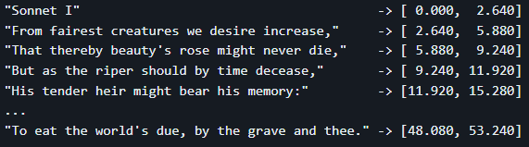
Building a Multilanguage Forced Aligner
Our problem statement is to develop/Improvise current Open-source Solutions for forced aligners to our use case - Indian Languages.
What is Aligning ?
The mapping of audio and text in a time interval, one can relate them to captions/subtitles.

Slide 3
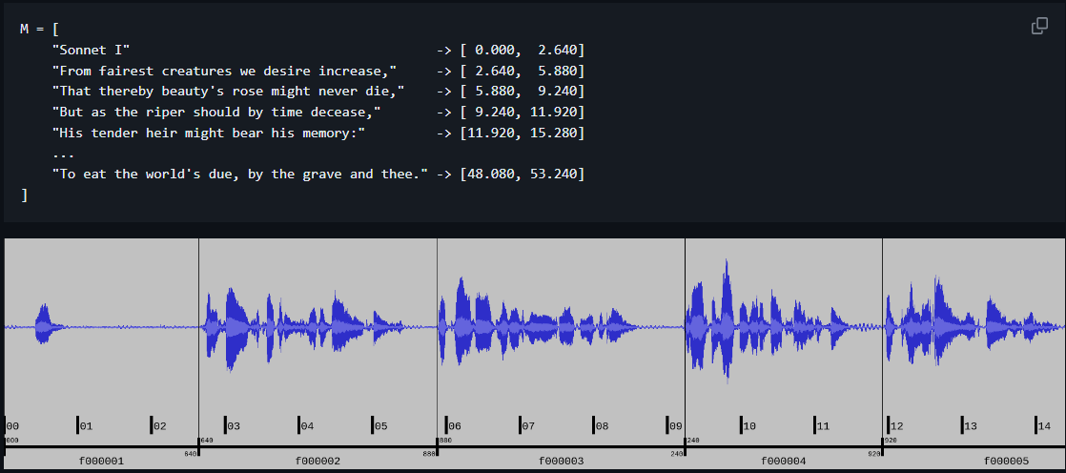
Aeneas
We chose to implement Aeneas for our Forced Alignment, and improvise it with our datasets’ audio and text limits.

Slide 4
How Aeneas Works?
Converts audio to mono channel and marks the intervals of voiced, unvoiced and silence regions.
Converts text to plain format to allocate fragments timestamps after aligning.
Using a TTS model, it obtains a Synthesized audio.
Both the initial audio (R) and synthesized (S), are then used to obtain MFCC matrices for both.
Afterwards, it performs a DTW (Dynamic time warping) technique to obtain a mapping between R and S.
This approach is O(N*M), N and M being the sizes of R and S.
Key Points :
As the approach is of exponential complexity, (M and N being directly proportional to Audio lengths), we need to optimize the way we feed the text data to aeneas and our audio files. It has been found out that Aeneas works best when the audio files are less than 30 seconds and delivers good speed even on smaller GPUs.

Slide 5
What we improvised
As noted that our audio should be in the range of 30 seconds, we needed to work on fragmenting the text. We noted that there is a general trend that a person stops speaking for around 0.5-3 second during a Full-Stop( . ), and a Comma ( , ).
So, we used this to track silence regions in the audio and split the audio up. Another thing to note is that in sentences which are spoken for longer than 30 seconds, generally have multiple commas in between, so that case is also taken care of .

Slide 6
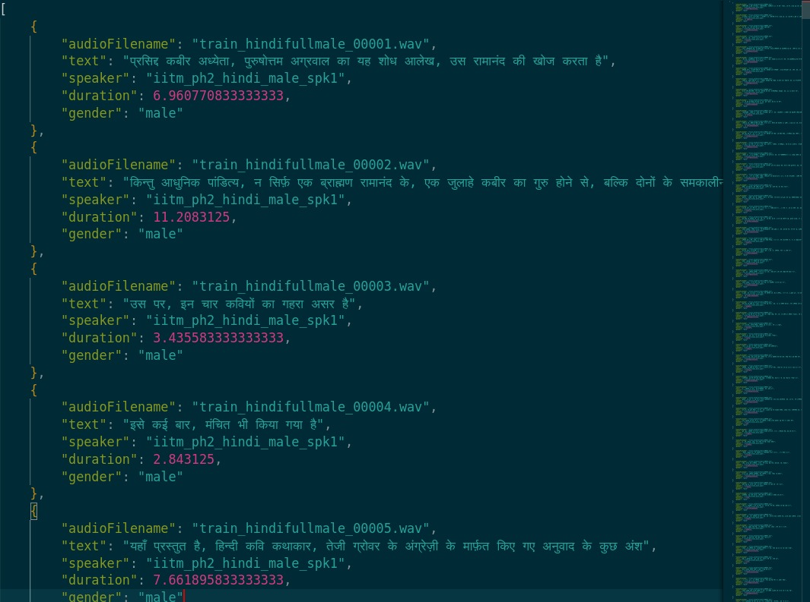
A View at our Dataset

Slide 7
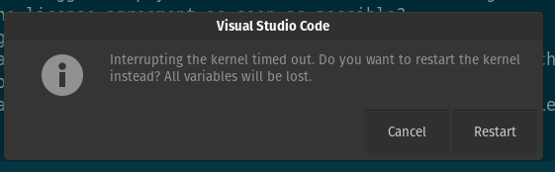
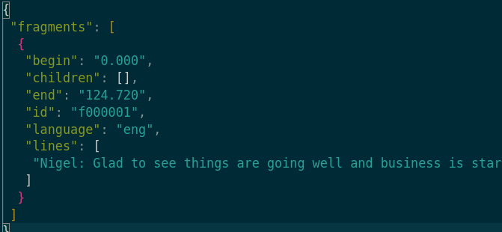
Issues with Normal Aeneas
Fails on longer audios.
(>5 minutes)
Longer samples
in transcriptions gives
poor resolution.

Slide 8
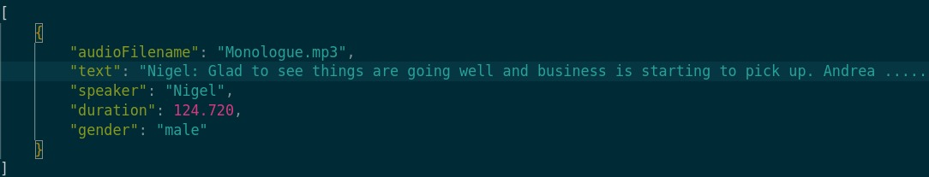
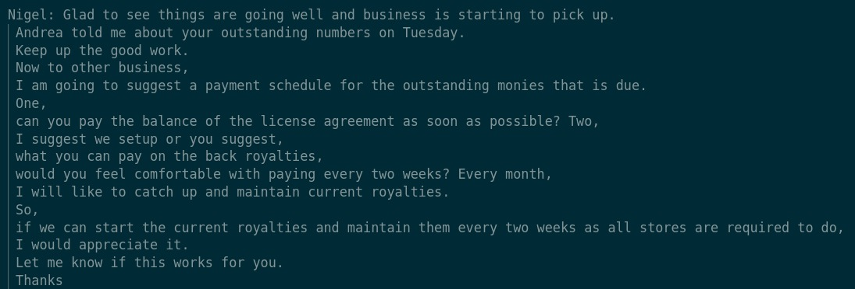
Results
Language - English
Input ⇒
Formatted text which will be ⇒
used to split the audio files

Slide 9
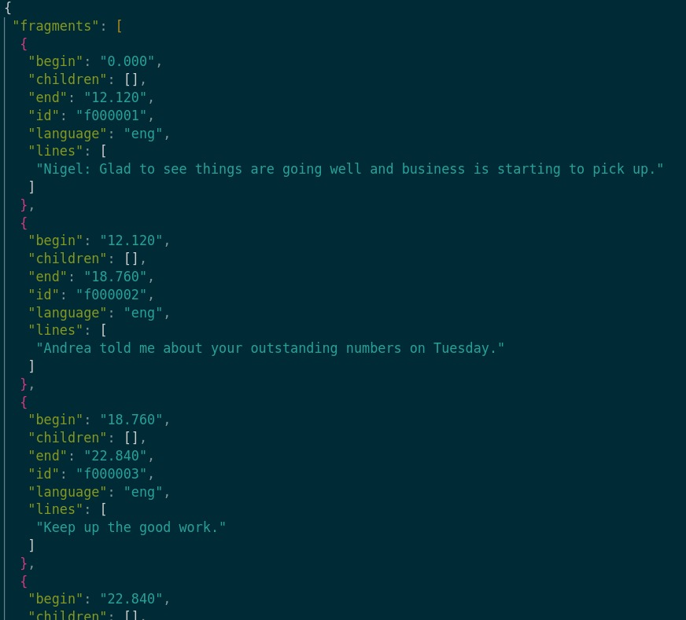
Output for English

Slide 10
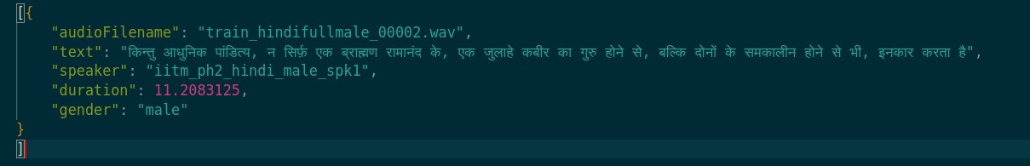
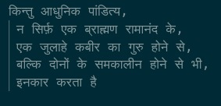
Results
Language - Hindi
Input ⇒
Formatted text which will be ⇒
used to split the audio files

Slide 11
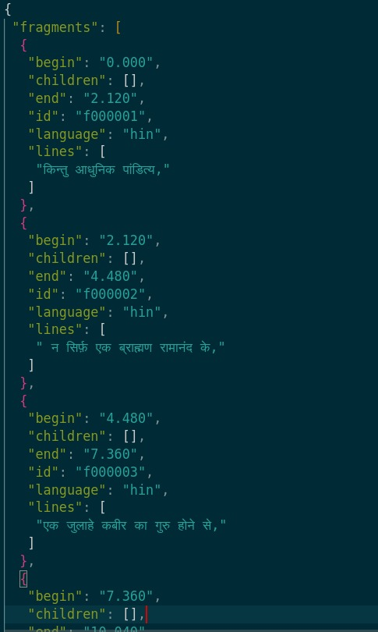
Output for Hindi

Slide 12
Results
What we improved :
The overall per segment run-time has been brought down so that it can be run on smaller GPUs, as the chunks now are at <30 seconds.
Better Alignment results than normal Aeneas, as there is a tracking error in longer audios.
Better Resolution on sentence level, as Aeneas merges 2-3 sentences in case of longer audios and confuses it with the synthesized audio from TTS.
What can be Improvised:
Aeneas lacks a compatible wrapper for Indian Languages and for each language we need to import the corresponding compatible option. So a Wrapper which covers all Indian Languages can be better.

Slide 13
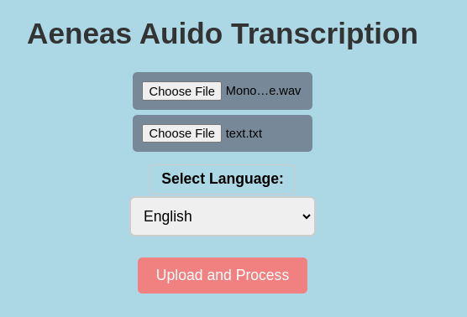
Website Demo

Slide 14
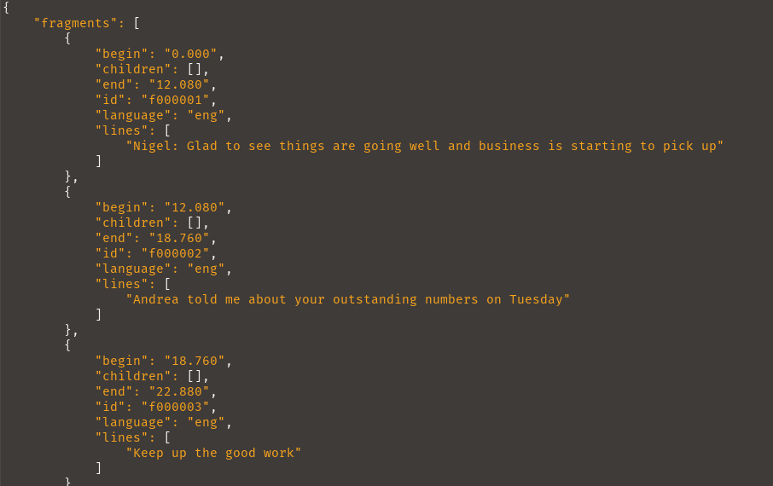
How to Use
The user need to upload 2 files :
- An Audio file
- A corresponding text file
The Website Outputs the
transcription into a .json file.

Slide 15
Thank You

